Slide 1

Market Basket Analysis
Team:
B. Shashank reddy
Balaji pappala
Srisai panjala
Raviteja mucharla

Slide 2
Tech Stack Used
Programming Languages: Python
Libraries and Frameworks: NumPy, Pandas, Matplotlib, plotly, mlxtend
Model Deployment: Streamlit

Slide 3
How a Typical data Science problem can be solved?
Problem Definition: Clearly define the problem at hand and its significance.
Data Collection: Gather relevant and diverse data to build a robust model.
Data Preprocessing: Clean and preprocess the data to ensure quality and consistency.
Exploratory Data Analysis (EDA): Understand the characteristics of the dataset.
Feature Engineering: Extract or create features that enhance the model's performance.
Model Selection: Choose an appropriate model based on the nature of the problem.
Model Training: Train the selected model on the labeled dataset.
Model Evaluation: Assess the model's performance using relevant metrics.
Iterative Refinement: Based on evaluation results, refine the model and repeat the process if needed.

Slide 4
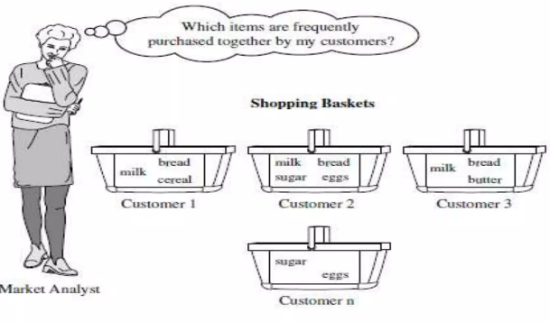
Objective
To find Which items are purchased together during shopping, from large amount of Transactions.

Slide 5
What is Market Basket Analysis?
Market Basket Analysis (MBA) is a data mining technique widely used in retail and e-commerce industries to uncover associations and patterns within transactional data. By analyzing customer purchase behavior, MBA identifies frequently co-occurring items in transactions, revealing insights into consumer preferences and product relationships. This method enables retailers to understand buying patterns, optimize product placement, cross-sell and upsell products, and personalize marketing strategies. MBA leverages algorithms such as Apriori and FP-growth to efficiently mine large transaction datasets, generating actionable insights to improve business decision-making and enhance customer satisfaction.

Slide 6
System Architecture
Collecting Data
Data Preprocessing
Exploratory Data Analysis
Applying Algorithm
Generating Association Rules
Integrating with Streamlit

Slide 7
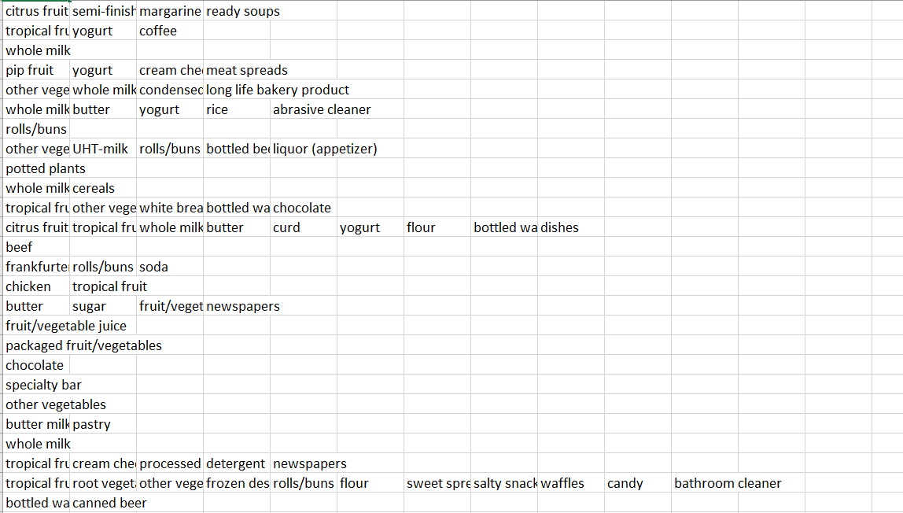
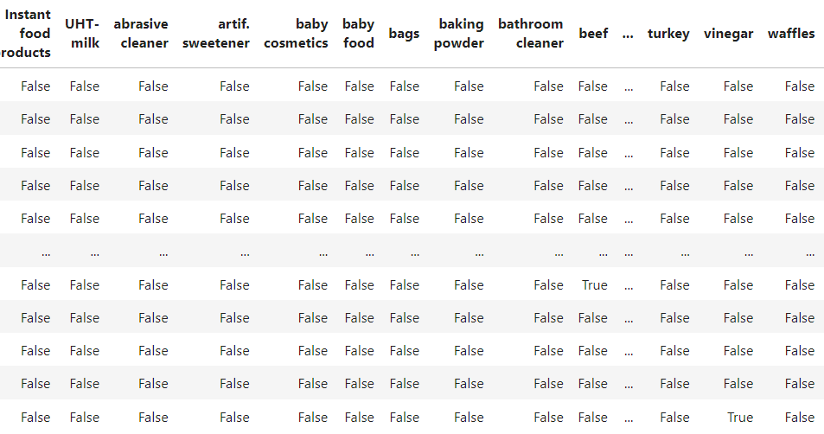
Dataset
RAW DATA
TRANSFORMED DATA

Slide 8
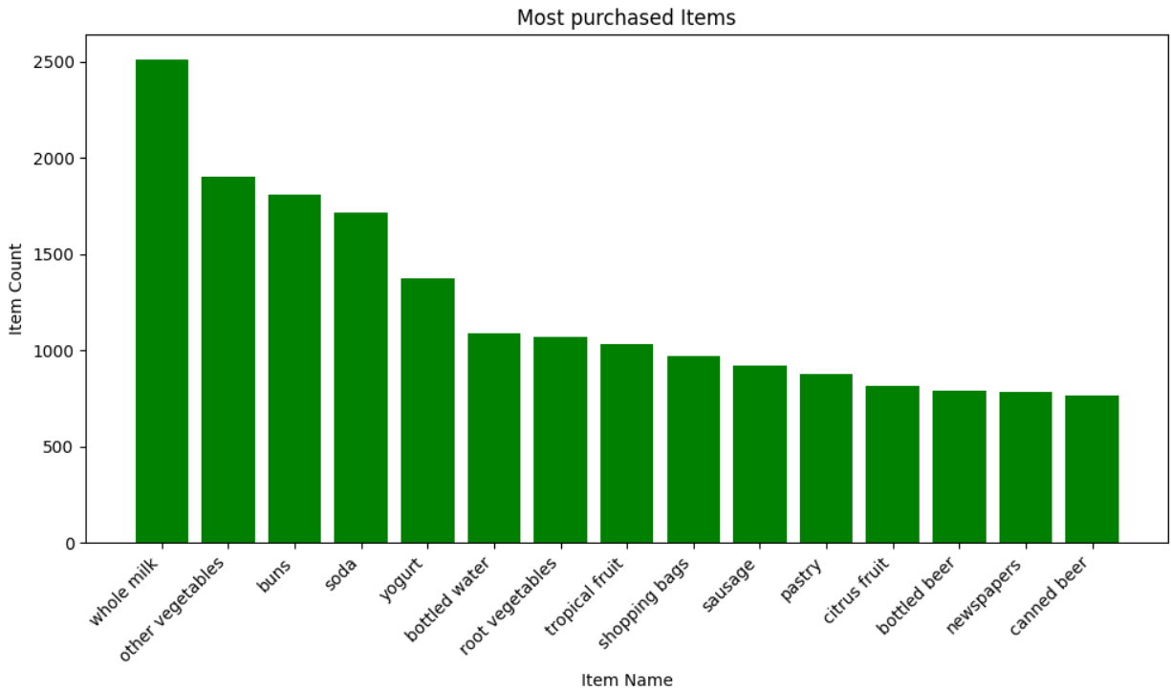
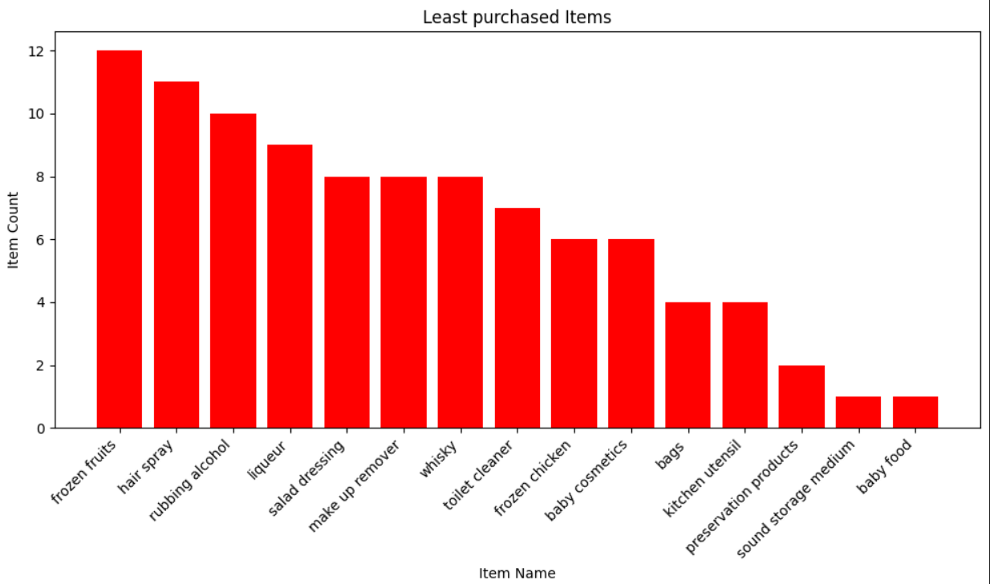
Exploratory Data Analysis
__________________________________________________________________________________________

Slide 9
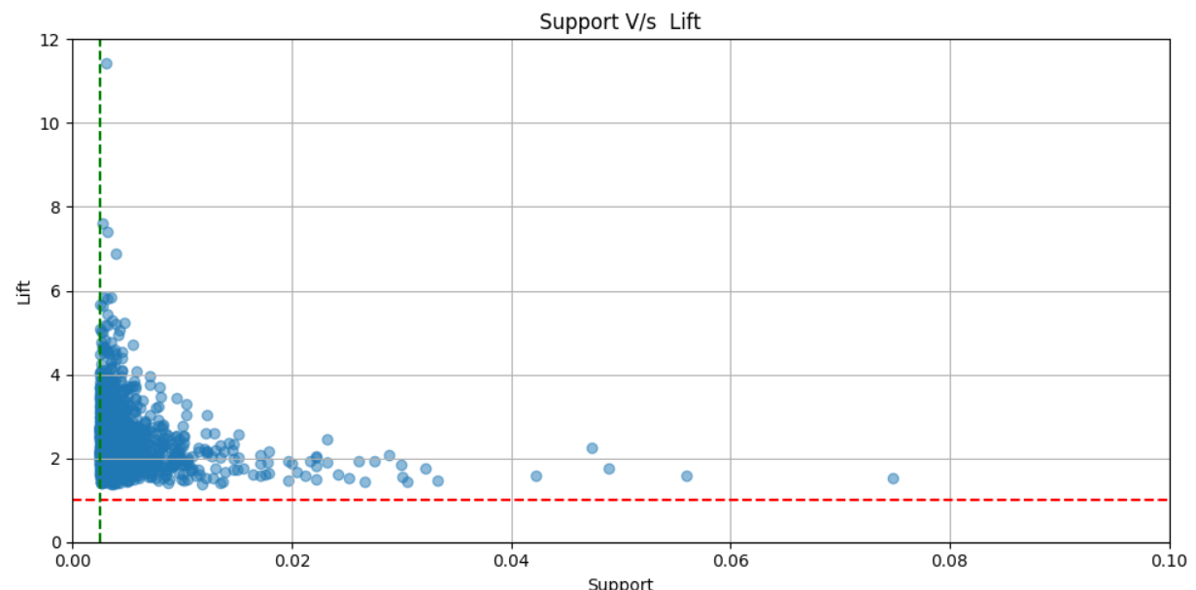
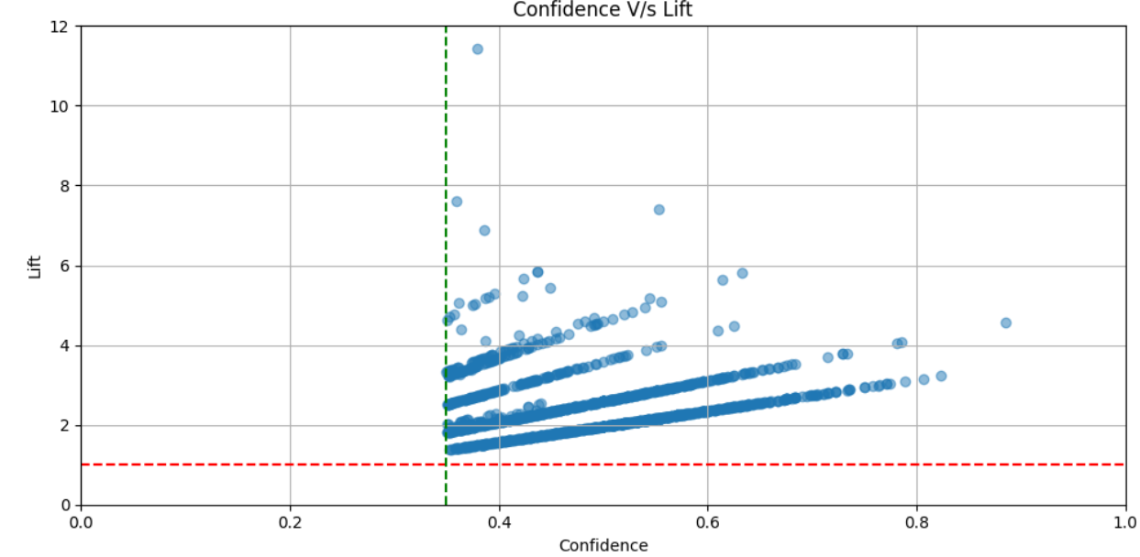
Exploratory Data Analysis

Slide 10
FP-Growth Algorithm
The FP Growth algorithm in data mining is a frequent itemset mining algorithm used to discover frequently occurring patterns in large datasets.
It generates frequent item sets efficiently by constructing an FP-Tree data structure that represents the input dataset and mining the tree for recurring patterns.
It is widely used in various applications such as market basket analysis, bioinformatics, and web usage mining.

Slide 11
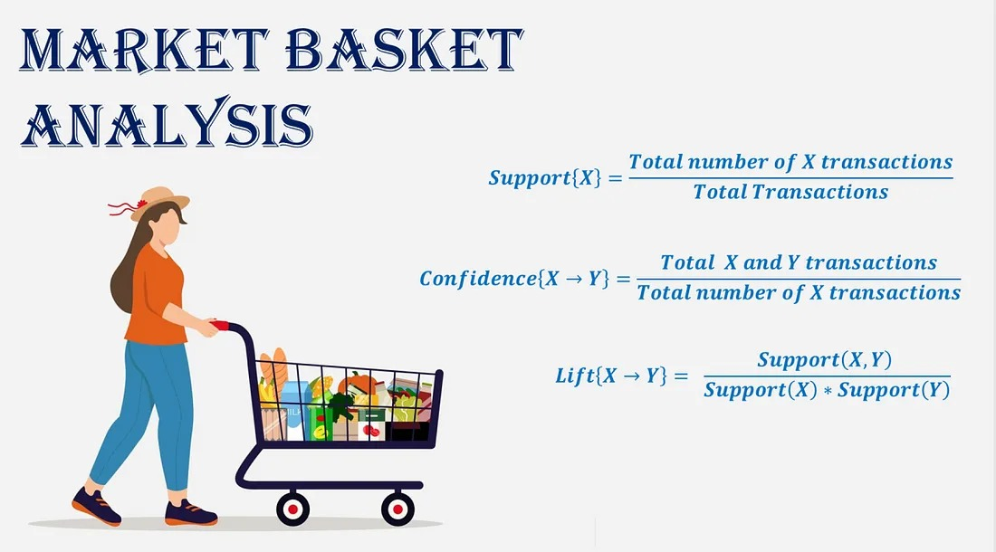
Metrics used in MBA
1. SUPPORT
2. CONFIDENCE
3. LIFT

Slide 12
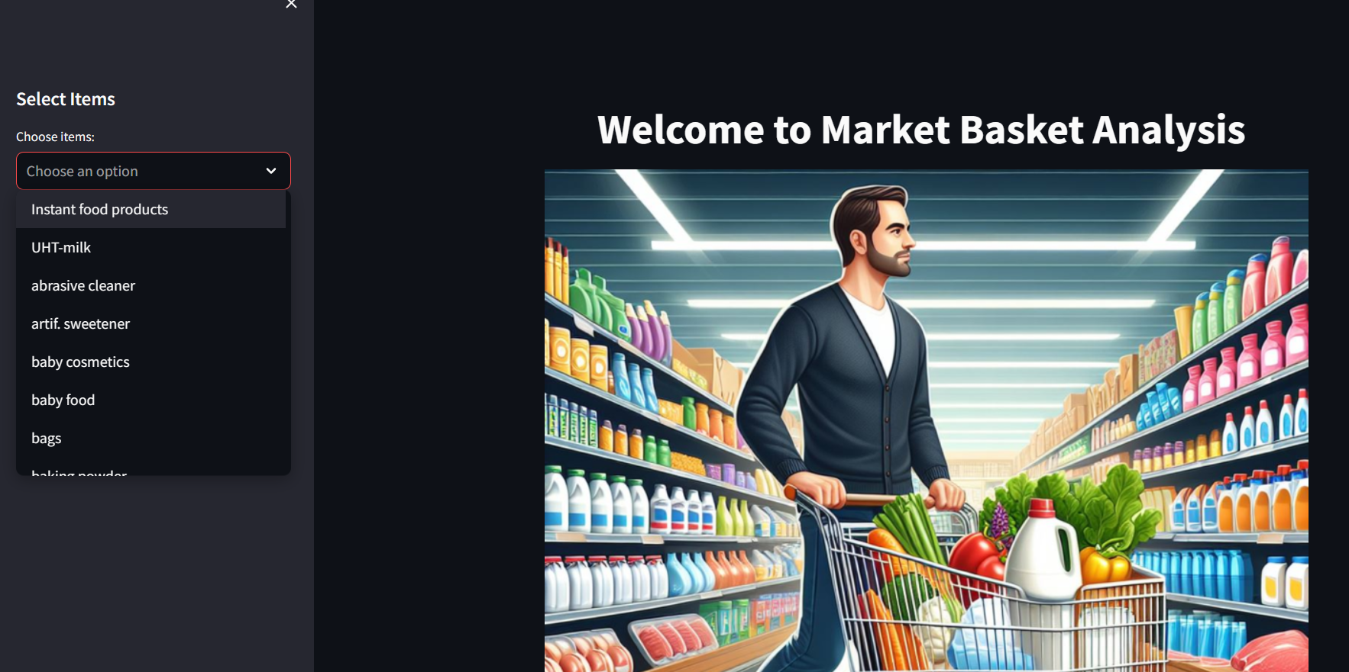
Project Snapshots

Slide 13
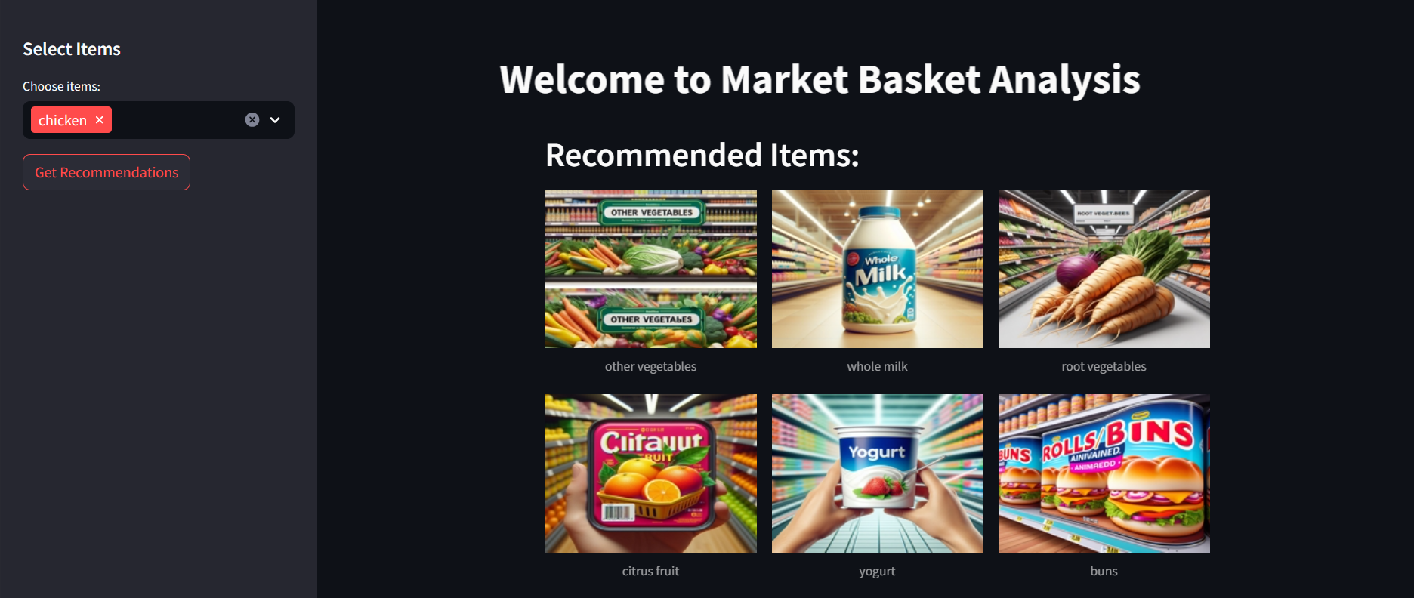
Project Snapshots

Slide 14
APPLICATIONS
Online Streaming Services
E-commerce
APPICATIONS
Tele Communications
Hospitality
Banking/
Finance
Healthcare

Slide 15
Thank You

